Slide 1



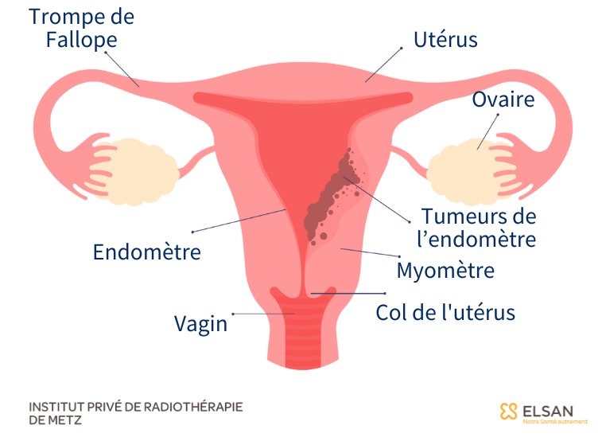
STAGE TOPIC :
Bio-informatics analysis of public data : Study of genomics variants associated to cervicals adénocarcinoma
Probationer
Master
Dr TIBIRI
Ian Lucas KABORE

Slide 2
Plan
Generalities
Symptoms
Diagnostic
Adénocarcinoma et carcinoma epidermoïde

Slide 3
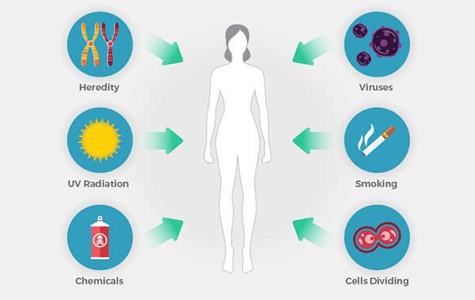
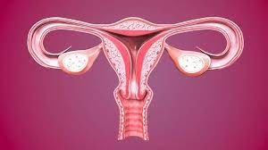
Generalities
Cancer
Abnormal cell + Excessive proliferation
Causes of cancer
Uterus

Slide 4
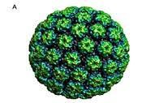
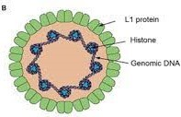
Generalities
Virus (HPV)
Stades
Stade 1 Micro-invasif cancer
Stade 1A Unseen on bare eye
Stade 1B Seen on bare eye
Stade 2 Proximal expansion
Stade 2A Vaginal extension
Stade 2B Extravaginal extension
Stade 3 Distal expansion
Stade 3A reach 1/3 of the lower of vagina
Stade 3B reach pelvis wall/ ureter
Stade 4 Métastasis
Stade 4A la majority of pelvis and more
Stade 4B other part of the body (lung, liver, bone …)
Circular DNA virus
Non-envelopped virus
Virus à capside icosaédrique

Slide 5

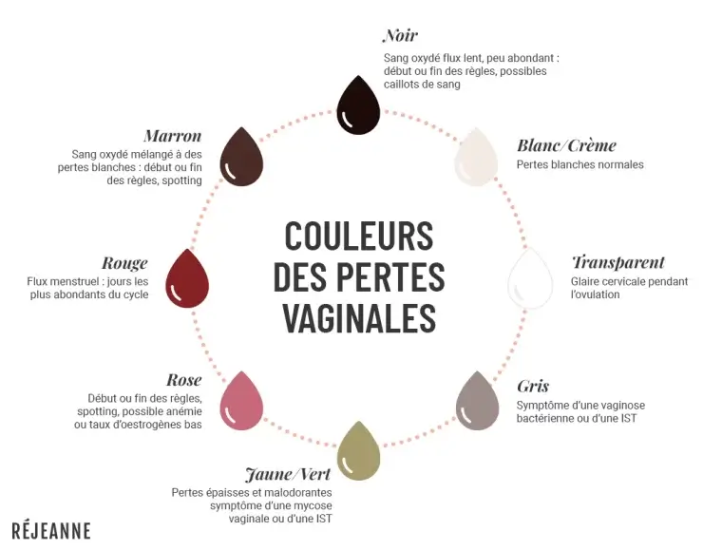
Symptoms
Hors menstrues
Spontaneous ou provocated par des rapports sexuels
Disorderly menstrual period
1. Vaginal bleeding
3. Pelvis pains
2. Vaginal flow

Slide 6
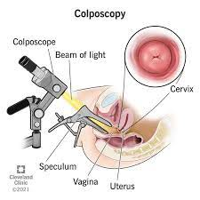
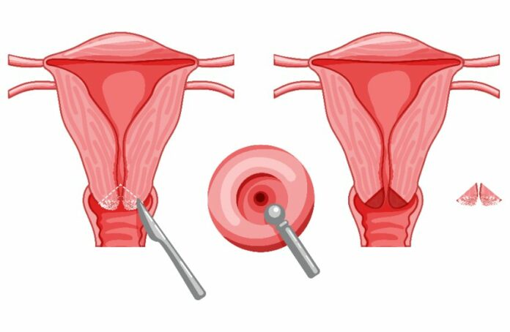
Diagnostic
Symptom
Cervical rubbed with abnormals cells
and/or
Suspicion of cervix cancer
Biopsie by coloscopy
Biopsie by conisation

Slide 7
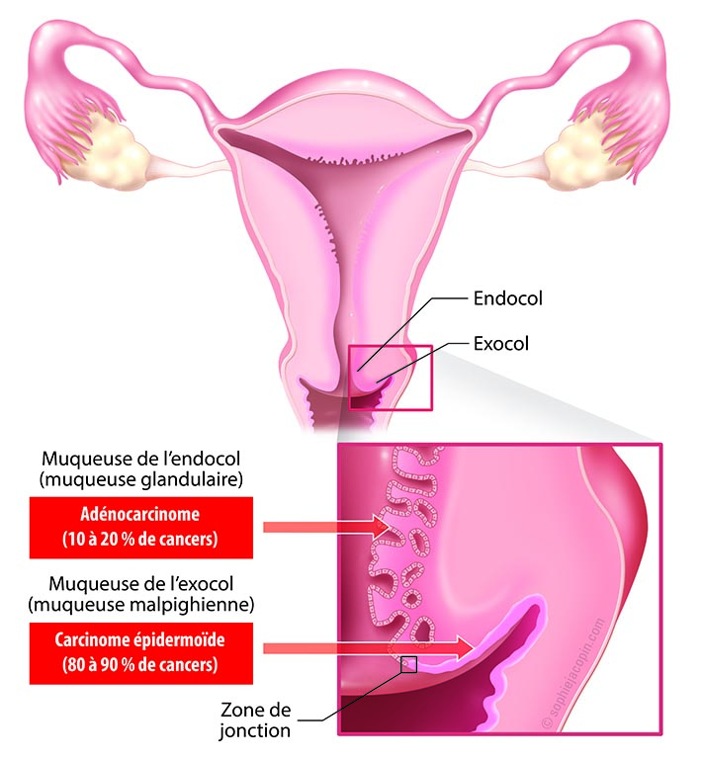
Adenocarcinome and carcinome epidermoïde
Cancer
Solid cancer
Liquid cancer
Metastasic cancer
Secondary cancer
Carcinome
sarcome
Carcinome épidermoïde
Adénocarcinome
16 18 31 33 34 35 39 45 51 52 56 58 66 68 70
HPV
Cause of cervicus cancer

Slide 8
Adenocarcinoma and carcinoma epidermoïde
Why adénocarcinoma ?
Vital pronostic more deadly
few information
Augmentation of cases numbers
Majority of genes are associated to non coding area. That’s the problem
Positively regulated genes
CEACAM5 ,TACSTD1 , S100P et MSLN
Adénocarcinoma
S100A9 et ANXA8
Carcinoma épidermoïde

Slide 9
Perspectives
Bio-informatics analysis of public data : Study of genomics variants associated to cervicals adénocarcinoma

